Slide 1

Faculty of Education
Student Forum
13 July 2017
CRICOS No. 00213J

Slide 2

Overview
Options available after 2017
Questions
Course progression handouts will be available for collection at the end of the forum
PowerPoint presentation will be emailed
CRICOS No. 00213J

Slide 3
Your options beyond 2017
Transfer to QUT’s Kelvin Grove campus, complete your studies with QUT and obtain a QUT degree.
If you have completed 96 credit points with QUT by the beginning of Semester 1, 2018 and you wish to remain at the Caboolture Campus, you will be eligible to obtain a QUT degree cross-institutionally, whereby QUT grants advanced standing towards your QUT degree for any units taught by USC.
If you decide to remain at the Caboolture campus from Semester 1, 2018 and by that point you have NOT YET completed 96 credit points but you wish to obtain a QUT degree, you will be supported to complete 96 credit points with QUT by the end of 2018. If it seems unlikely that you will complete 96 credit points by the end of 2018, your options will be discussed with you before that point.
Transfer to USC and obtain a USC degree either at Caboolture or another USC Campus.

Slide 4
Option 1. Transfer to Kelvin Grove campus
Available to all QUT Caboolture students regardless of current degree progress.
No GPA cut-offs required to transfer to the Kelvin Grove campus.
Continue your study following the same enrolment progression at Kelvin Grove that you would have at Caboolture.
Confirmation and processing of your transfer will occur in August
Kelvin Grove orientation day for Education students transferring from Caboolture on Monday, 20 November starting at 10am.

Slide 5
Option 2. Remain at Caboolture to study towards a QUT degree
Available if you have passed at least 96 credit points (8 units) in your QUT degree by the beginning of Semester 1, 2018.
Your remaining units will be studied cross-institutionally with USC and granted as advanced standing towards your QUT degree.
Progressions have been mapped for students following the standard QUT degree progression.
Once you have decided to take option 2 contact the Faculty Student Affairs Office on educationenq@qut.edu.au or 07 3138 3947 for a personalised course progression which will be emailed to you.

Slide 6
If you are studying primary education you will not be required to complete an internship at the end of your degree.
When studying units cross-institutionally with USC, you will be treated by USC as one of their degree students.
QUT and USC Bachelor of Education degrees are accredited with AITSL and ACECQA (for Early Childhood). They are both recognised in Queensland and interstate as meeting the requirements for teacher registration.

Slide 7
Option 3: Wish to study at Caboolture but haven’t completed 96 credit points by Semester 1, 2018
You will be supported to complete 96 credit points with QUT by the end of 2018.
Contact Student Affairs and individual progressions will be worked out which may include studying units online.
After you have obtained 96 credit points, QUT will grant advanced standing towards your QUT degree for any units taught cross-institutionally by USC.

Slide 8
Option 4. Transfer to USC degree
If you have passed fewer than 96 credit points in your QUT degree at the beginning of Semester 1, 2018 or by end of 2018, a transfer to USC to complete a USC degree may suit you best.
Process for transfer to USC yet to be determined.
Credit towards USC based on study undertaken in the equivalent QUT degree will be granted to ensure you are not disadvantaged by transferring.

Slide 9
Professional Experience
Regardless of which option you choose you will successfully complete the minimum required professional experience for your course:
Early Childhood: 95 days in early childhood, kindergarten and primary school settings
Primary: 80 days in a primary school setting
If you study your remaining units through USC either as a cross-institutional student (option 2) or you transfer your degree to USC (option 3) USC will manage your required professional experience days and inform QUT to ensure you have successfully completed the required professional experience days.

Slide 10
Course Mapping if you wish to receive a QUT Degree

Slide 11
BACHELOR OF EDUCATION (EARLY CHILDHOOD)

Slide 12
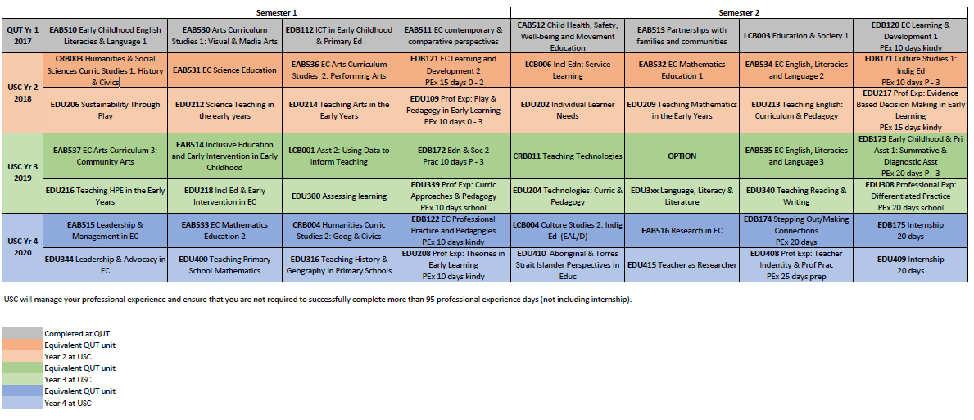
Bachelor of Education (Early Childhood) - standard structure
Completion of QUT year 1 at the beginning of Semester 1, 2018

Slide 13
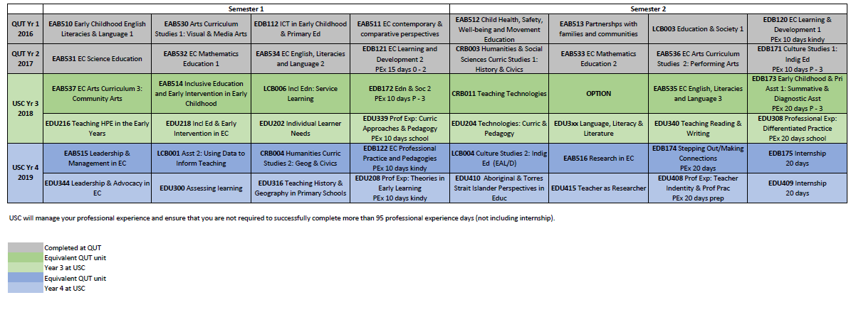
Bachelor of Education (Early Childhood) - standard structure
Completion of QUT year 2 at the beginning of Semester 1, 2018

Slide 14
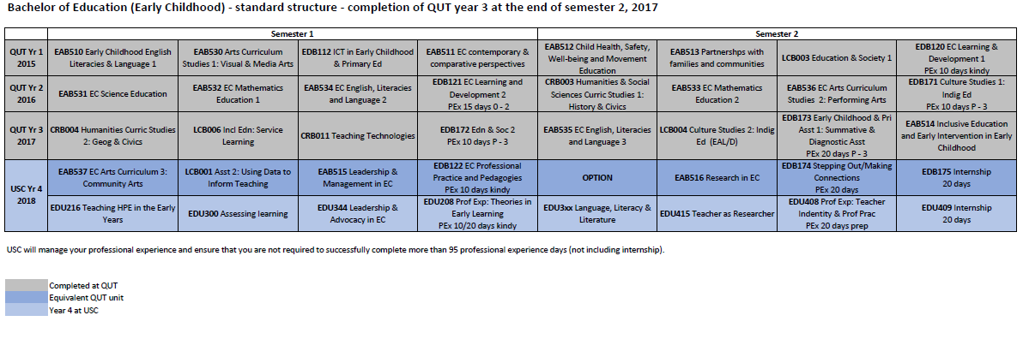
Bachelor of Education (Early Childhood) - standard structure
Completion of QUT year 3 at the beginning of Semester 1, 2018

Slide 15
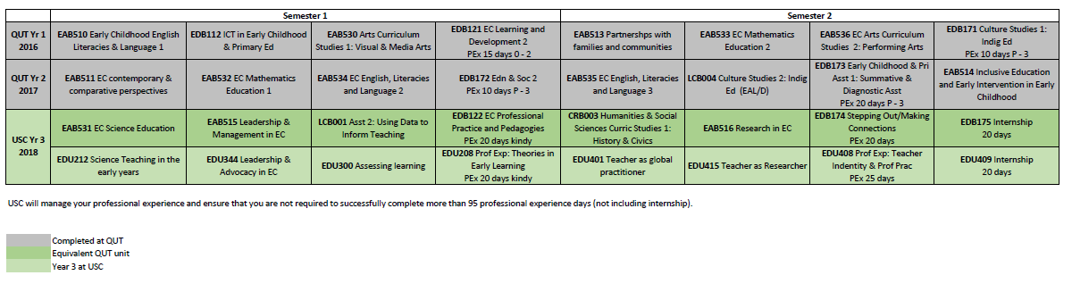
Bachelor of Education (Early Childhood) - Diploma structure
Completion of QUT year 3 at the beginning of Semester 1, 2018

Slide 16
BACHELOR OF EDUCATION (Primary)

Slide 17
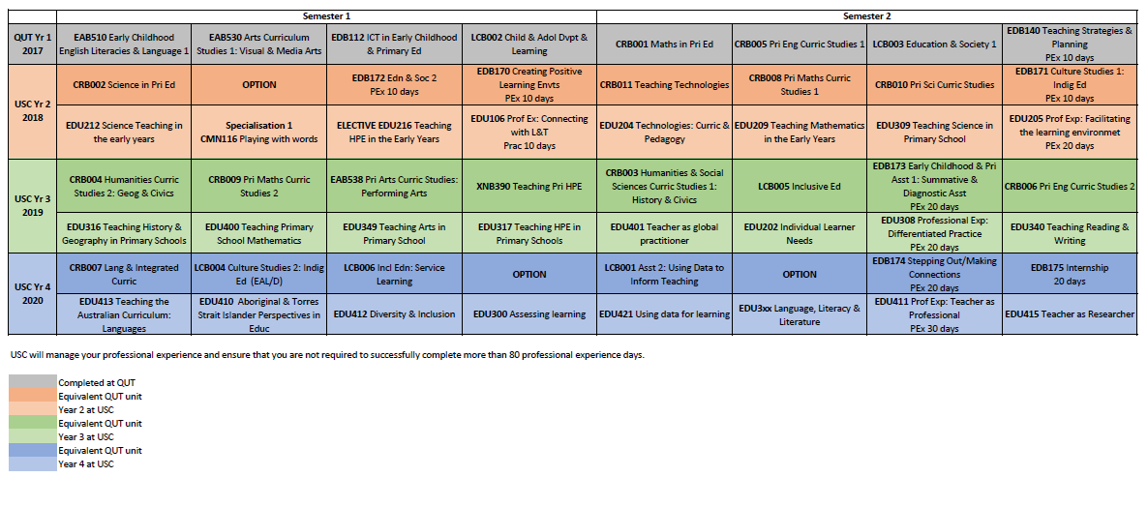
Bachelor of Education (Primary)
Completion of QUT year 1 at the beginning of Semester 1, 2018

Slide 18
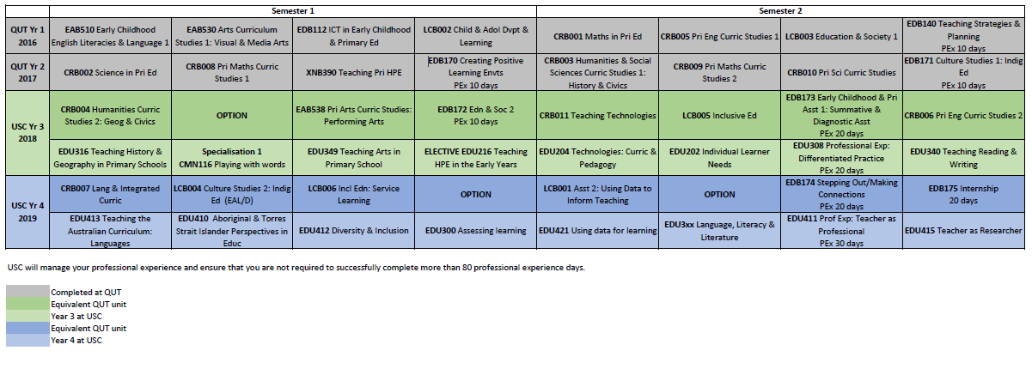
Bachelor of Education (Primary)
Completion of QUT year 2 at the beginning of Semester 1, 2018

Slide 19
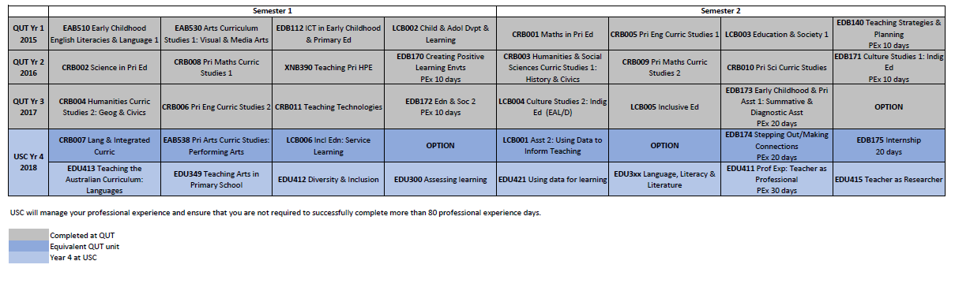
Bachelor of Education (Primary)
Completion of QUT year 3 at the beginning of Semester 1, 2018

Slide 20
Your options beyond 2017
Transfer to QUT’s Kelvin Grove campus, complete your studies with QUT and obtain a QUT degree.
If you have completed 96 credit points with QUT by the beginning of Semester 1, 2018 and you wish to remain at the Caboolture Campus, you will be eligible to obtain a QUT degree cross-institutionally, whereby QUT grants advanced standing towards your QUT degree for any units taught by USC.
If you decide to remain at the Caboolture campus from Semester 1, 2018 and by that point you have NOT YET completed 96 credit points but you wish to obtain a QUT degree, you will be supported to complete 96 credit points with QUT by the end of 2018. After you have obtained 96 credit points, QUT will grant advanced standing towards your QUT degree for any units taught cross-institutionally by USC. If it seems unlikely that you will complete 96 credit points by the end of 2018, your options will be discussed with you before that point.
Transfer to USC and obtain a USC degree either at Caboolture or another USC Campus that offers Initial Teacher Education degrees.

Slide 21
Standard course progressions are available on your way out.
If you are transferring to KG campus you will receive an invitation to a special KG orientation on 20th November 2017.
Enquiries/further information:
educationenq@qut.edu.au or
3138 3947
CRICOS No. 00213J

Slide 22
Questions?
CRICOS No. 00213J

